Slide 1
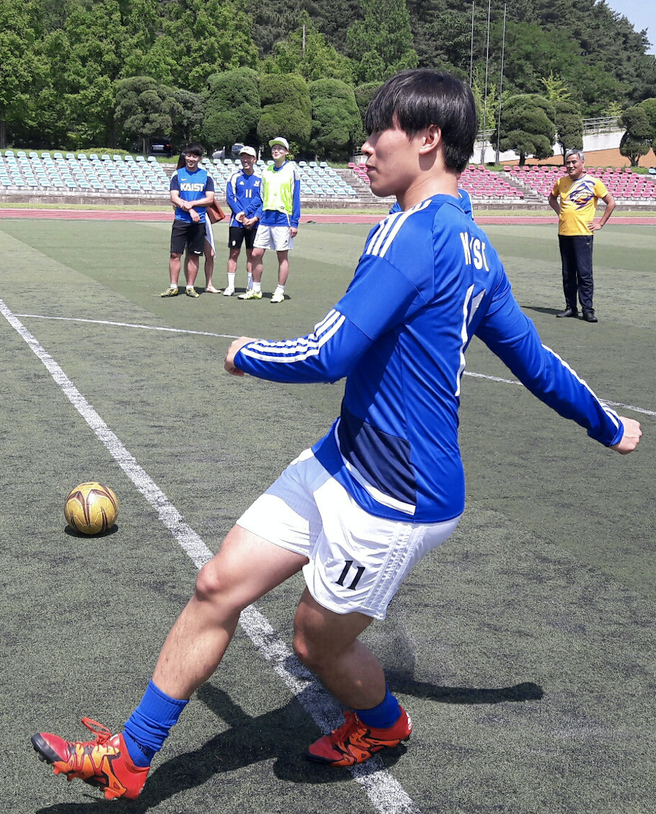

CPA
Course Project Assistant
CS408(F) Computer Science Project
Team Hurricane
Advisor: Juho Kim
Hyunsu Hyungrok
Notes:
Good afternoon,
Welcome to Team Hurricane’s final presentation. I am Hyunsu and this is Hyungrok.
Our project title is CPA which stands for Course Project Assistant.

Slide 2

Previously..
CPA: Course Project Assistant
Notes:
Let me remind you what we’ve been working on.
We have mainly been focusing on team projects.
As team is a group of unique individuals with different thoughts and experiences,
There are lots of discussions and interactions within a team to achieve one same goal.

Slide 3
Previously..
CPA: Course Project Assistant
Management
Notes:
To achieve the goal efficiently, team management is crucial.
It facilitates any form of discussions and interactions within a team.
So, we decided to handle team management.
Then, we narrowed down our scope to the projects that are done during courseworks

Slide 4
Previously..
CPA: Course Project Assistant
Course Project
Management
Notes:
rather than any kind of team projects which is to broad to deal with.

Slide 5
Example Course Projects
CPA: Course Project Assistant
Course |  | Topic | Report | Present. | # Members
Landmark Discoveries of cell biology |  | Discovery of RNA interference | X | O | 5
Psychological Philosophy |  | AI: Self identity and Free Will | X | O | 4
Immunology |  | Reengineering CART cells for targeted therapy of autoimmune disease | X | O | 2
Omics Biology |  | CRISPR/Cas9 gene drive system | X | O | 2
Introduction to Machine Learning |  | Motion Capture Using Subspace Clustering | O | O | 2
Technology Management |  | Types and Patterns of Innovation | X | O | 3
Introduction to Business Administration |  | Human resource management in Google | O | O | 3
Nuclear Waste Management |  | Selection of waste storage site | X | O | 4
Nuclear Power Plant Design and Project |  | Improving the safety of nuclear power plants | X | O | 4
Multidisciplinary Capstone Design |  | Perturbation-resistant Camera App. | O | O | 6
Notes:
Here’s a list of example course projects.
You don’t have to understand line-by-line, but note that almost every project comes with giving a presentation,
And some with submitting reports.
To measure the amount of discussions going on within each team, we’ve investigated how many documents and slide decks they made.

Slide 6
Example Course Projects
CPA: Course Project Assistant
Course |  | Topic | # Docs | # Slides | # Members
Landmark Discoveries of cell biology |  | Discovery of RNA interference | 2 | 2 | 5
Psychological Philosophy |  | AI: Self identity and Free Will | 3 | 2 | 4
Immunology |  | Reengineering CART cells for targeted therapy of autoimmune disease | - | 2 | 2
Omics Biology |  | CRISPR/Cas9 gene drive system | - | 1 | 2
Introduction to Machine Learning |  | Motion Capture Using Subspace Clustering | 6 | 1 | 2
Technology Management |  | Types and Patterns of Innovation | 4 | 1 | 3
Introduction to Business Administration |  | Human resource management in Google | 5 | 2 | 3
Nuclear Waste Management |  | Selection of waste storage site | 3 | 2 | 4
Nuclear Power Plant Design and Project |  | Improving the safety of nuclear power plants | 2 | 1 | 4
Multidisciplinary Capstone Design |  | Perturbation-resistant Camera App. | >5 | 4 | 6
Notes:
We averaged the number and find out that

Slide 7
Example Course Projects
CPA: Course Project Assistant
Course |  | Topic | # Docs | # Slides | # Members
Landmark Discoveries of cell biology |  | Discovery of RNA interference | 2 | 2 | 5
Psychological Philosophy |  | AI: Self identity and Free Will | 3 | 2 | 4
Immunology |  | Reengineering CART cells for targeted therapy of autoimmune disease | - | 2 | 2
Omics Biology |  | CRISPR/Cas9 gene drive system | - | 1 | 2
Introduction to Machine Learning |  | Motion Capture Using Subspace Clustering | 6 | 1 | 2
Technology Management |  | Types and Patterns of Innovation | 4 | 1 | 3
Introduction to Business Administration |  | Human resource management in Google | 5 | 2 | 3
Nuclear Waste Management |  | Selection of waste storage site | 3 | 2 | 4
Nuclear Power Plant Design and Project |  | Improving the safety of nuclear power plants | 2 | 1 | 4
Multidisciplinary Capstone Design |  | Perturbation-resistant Camera App. | >5 | 4 | 6
3.5 Docs + 1.6 Slide Decks per Team
Notes:
each team manages about 3.5 documents and 1.6 slide decks.

Slide 8
Example Course Projects
CPA: Course Project Assistant
Ideation &
Discussion
Reports
Course |  | Topic | # Docs | # Slides | # Members
Landmark Discoveries of cell biology |  | Discovery of RNA interference | 2 | 2 | 5
Psychological Philosophy |  | AI: Self identity and Free Will | 3 | 2 | 4
Immunology |  | Reengineering CART cells for targeted therapy of autoimmune disease | - | 2 | 2
Omics Biology |  | CRISPR/Cas9 gene drive system | - | 1 | 2
Introduction to Machine Learning |  | Motion Capture Using Subspace Clustering | 6 | 1 | 2
Technology Management |  | Types and Patterns of Innovation | 4 | 1 | 3
Introduction to Business Administration |  | Human resource management in Google | 5 | 2 | 3
Nuclear Waste Management |  | Selection of waste storage site | 3 | 2 | 4
Nuclear Power Plant Design and Project |  | Improving the safety of nuclear power plants | 2 | 1 | 4
Multidisciplinary Capstone Design |  | Perturbation-resistant Camera App. | >5 | 4 | 6
3.5 Docs + 1.6 Slide Decks per Team
Implementation
Presentations
Notes:
From the figure, one may roughly imagine the amount of ideations and discussions going on within a team.
And, a document or a slide deck could be the exact product of the report or presentation.
In case of course projects in CS dept., it could be a plan or summary for implementation.
So, again, the team goes through sufficient amount of discussions and interactions to reach the goal.
Overall, we targeted to help management of the team projects which requires the amount of discussions and interactions
while any student may join this kind of team projects during their campus life.

Slide 9
Our goal
CPA: Course Project Assistant
Management of the course projects
that avails discussions and interactions
within a team
Notes:
So, our goal is to help ~ corresponding to almost every projects in campus ~~

Slide 10
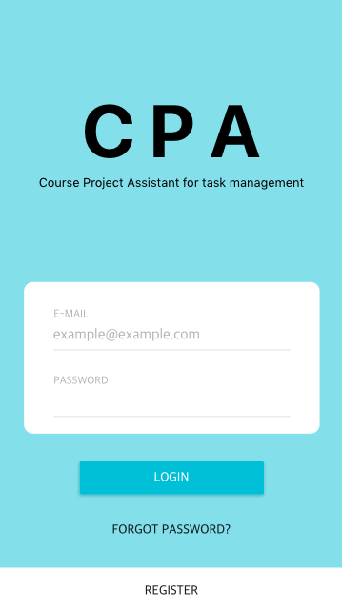
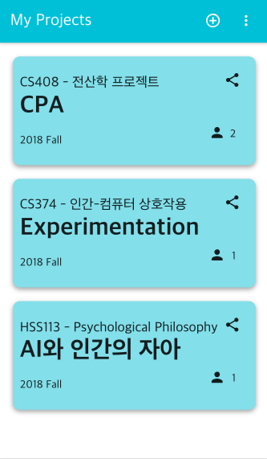
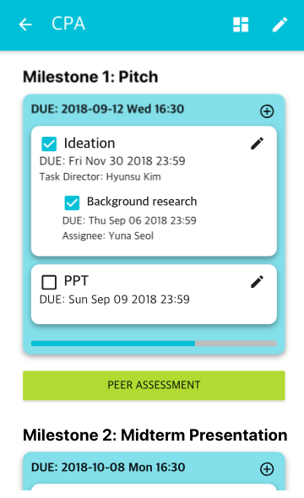
Solution
CPA: Course Project Assistant
Notes:
So, here’s the solution that we came up with and then implemented as a feature of our application, CPA:

Slide 11
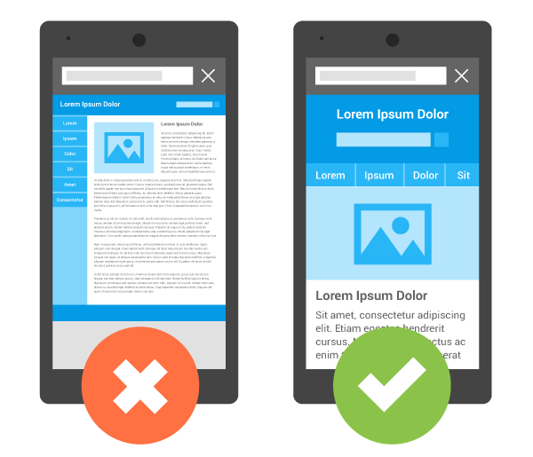
Solution
CPA: Course Project Assistant
1. Mobile-friendly UI for accessibility
Notes:
First, We’ve made our application mobile-friendly for accessibility

Slide 12

Solution
CPA: Course Project Assistant
1. Mobile-friendly UI for accessibility
2. Milestones setup for customization
Notes:
Second, ...
We captured that most course projects are tightly connected with specific goals,
such as giving presentations and submitting a report,
This allows user to easily transplant their project into our application

Slide 13

Solution
CPA: Course Project Assistant
1. Mobile-friendly UI for accessibility
2. Milestones setup for customization
3. Peer assessment for collaborative teamwork
Notes:
So, let’s check out in CPA

Slide 14


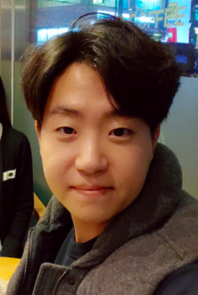

Demo
CPA: Course Project Assistant

Slide 15
Demo
CPA: Course Project Assistant
Hey, guys. I’ve opened a slot for our project in CPA. Join!

Slide 16
Demo
CPA: Course Project Assistant
Hey, guys. I’ve opened a slot for our project in CPA. Join!
Here’s the link
https://cpa1-5711c.firebaseapp.com/share?id=-LSUBmLSwxEwZTTdDgbs

Slide 17
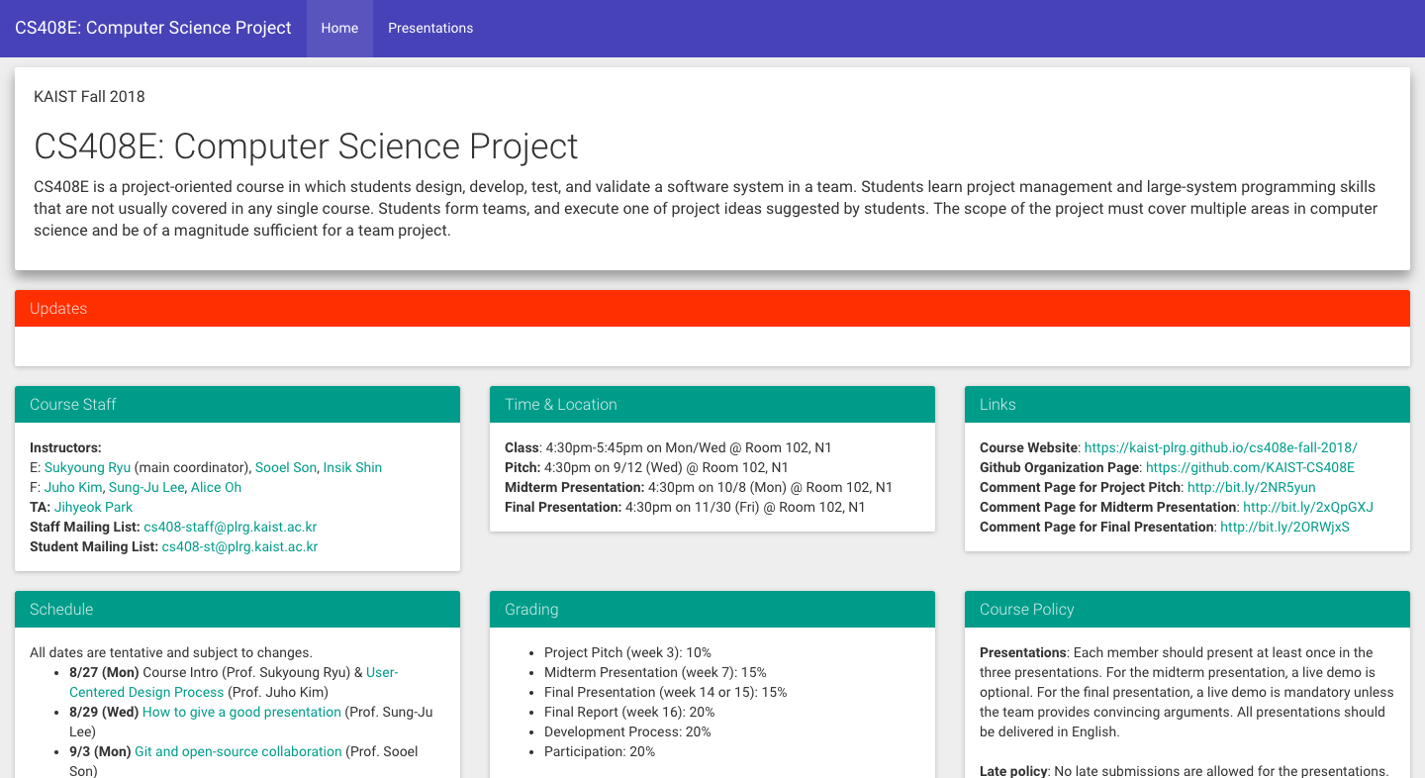
Demo
CPA: Course Project Assistant

Slide 18
Demo
CPA: Course Project Assistant

Slide 19
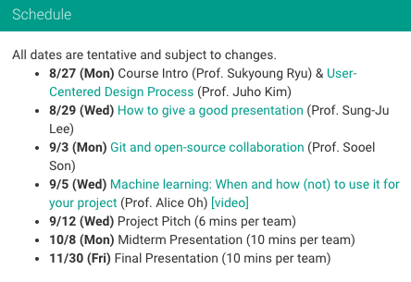
Demo
CPA: Course Project Assistant

Slide 20
Demo
CPA: Course Project Assistant

Slide 21
Demo
CPA: Course Project Assistant
Notes:
Back to the team,

Slide 22
Demo
CPA: Course Project Assistant
Hyungrok, can you give presentations on our pitch?
Notes:
Hyunsu asks Hyungrok to give presentations on their project pitch

Slide 23
Demo
CPA: Course Project Assistant
Hyungrok, can you give presentations on our pitch?
Okay:)
Notes:
Hyungrok accepts and then add himself a task for giving presentations.

Slide 24
Demo
CPA: Course Project Assistant
Notes:
Thanks to CPA, Hyungrok gave nice presentations for their pitch. Now, the first milestone, pitch has completed.
So the peer evaluation button has activated.
It automatically becomes active if due of the milestone pasts.

Slide 25
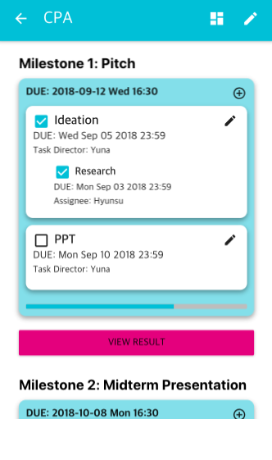
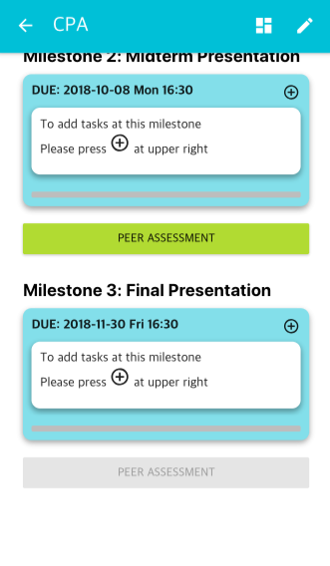
Demo
CPA: Course Project Assistant

Slide 26
Demo
CPA: Course Project Assistant

Slide 27
Demo
CPA: Course Project Assistant
Hyungrok was..
Hyunsu was..
Hyungrok was..
Yuna was..
Yuna was..
Hyunsu was..

Slide 28
Demo
CPA: Course Project Assistant

Slide 29
Demo
CPA: Course Project Assistant

Slide 30

Demo
CPA: Course Project Assistant
Notes:
By tapping on view results, they could see the scores and comments from their annonymous teammates, and could keep their work or do better in upcoming milestones.

Slide 31



Development
CPA: Course Project Assistant
 | Popular Javascript Web Framework Easy to handle states Many UI Frameworks ( ex. Material UI )
 | Real-time Database Serverless Easy to deploy
React
Firebase
Notes:
Now, let’s move on to development stack.
CPA has a lot of user state to handle like user project and milestones.
So we selected react as a front-end since react provides easy state handling.
Since CPA do not need heavy server side logic, we utilized serverless feature of firebase.
Also, using firebase real time database, we solved concurrency issues.

Slide 32
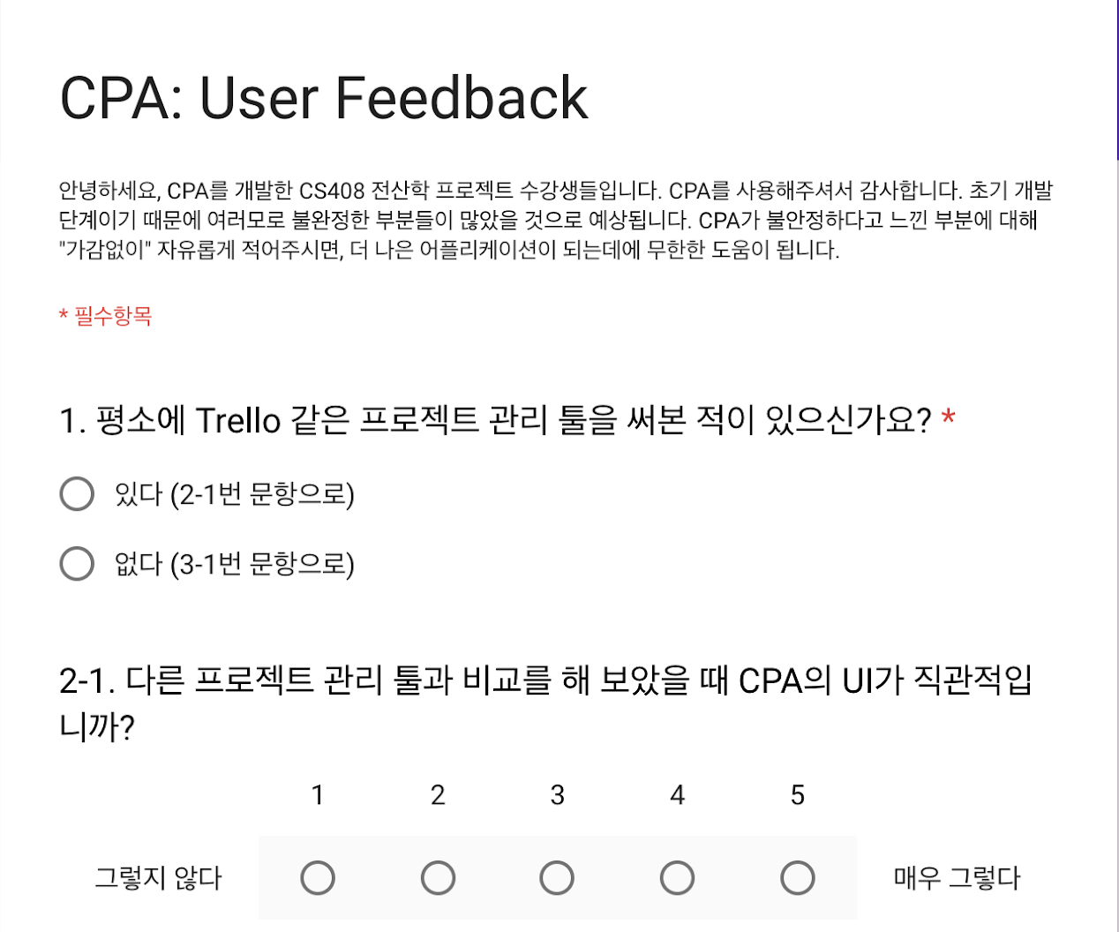
User Study
CPA: Course Project Assistant
Sample
1 team on CS473
(Intro. to social computing)
1 team on company
3 individuals
Notes:
After development, we conducted user test and user survey.
We had sample of 2 team and 3 individuals.

Slide 33
User Study: Evaluation
CPA: Course Project Assistant
Mobile friendly UI
Easy milestone setting
Peer Assessment
Notes:
Our main features are those three things.
So we mainly evaluated those features.

Slide 34
User Study: Evaluation
CPA: Course Project Assistant
Group 1
People who have used project management tool
Group2
People who have not used project management tool
Notes:
We seperated users into two groups
people who have used project management tool and people who did not.
Group 1 is for evaluating differences with other project management tools.
Group 2 is for evaluating usability of CPA.

Slide 35
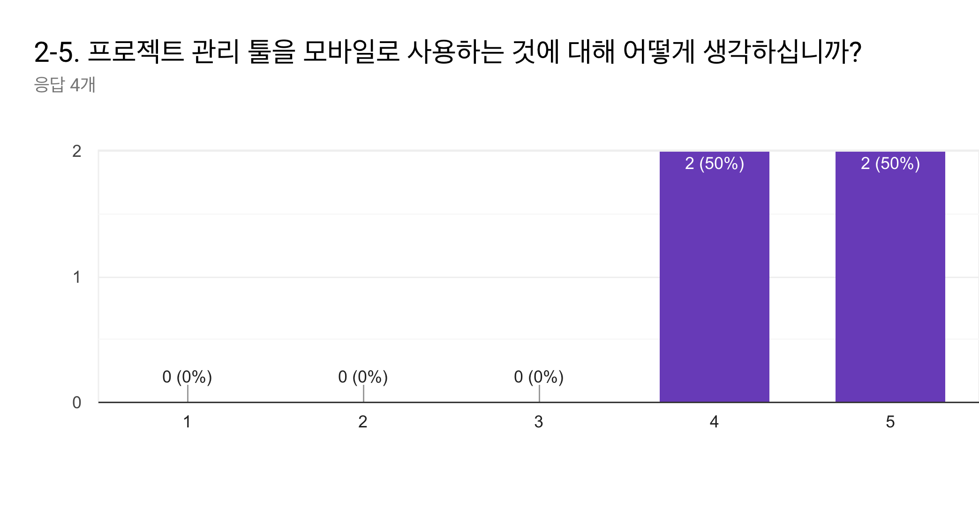
User Study: Result
CPA: Course Project Assistant
Group 1: Mobile Friendly UI
What do you think of using project management tool in mobile environment?
Notes:
Responses scored average 4.5 for mobile usability.

Slide 36
User Study: Result
CPA: Course Project Assistant
Group 1: Mobile Friendly UI
What do you think of using project management tool in mobile environment?
Both web and mobile web will be better.
Notes:
One of comment in this question is that both web and mobile will be better.

Slide 37
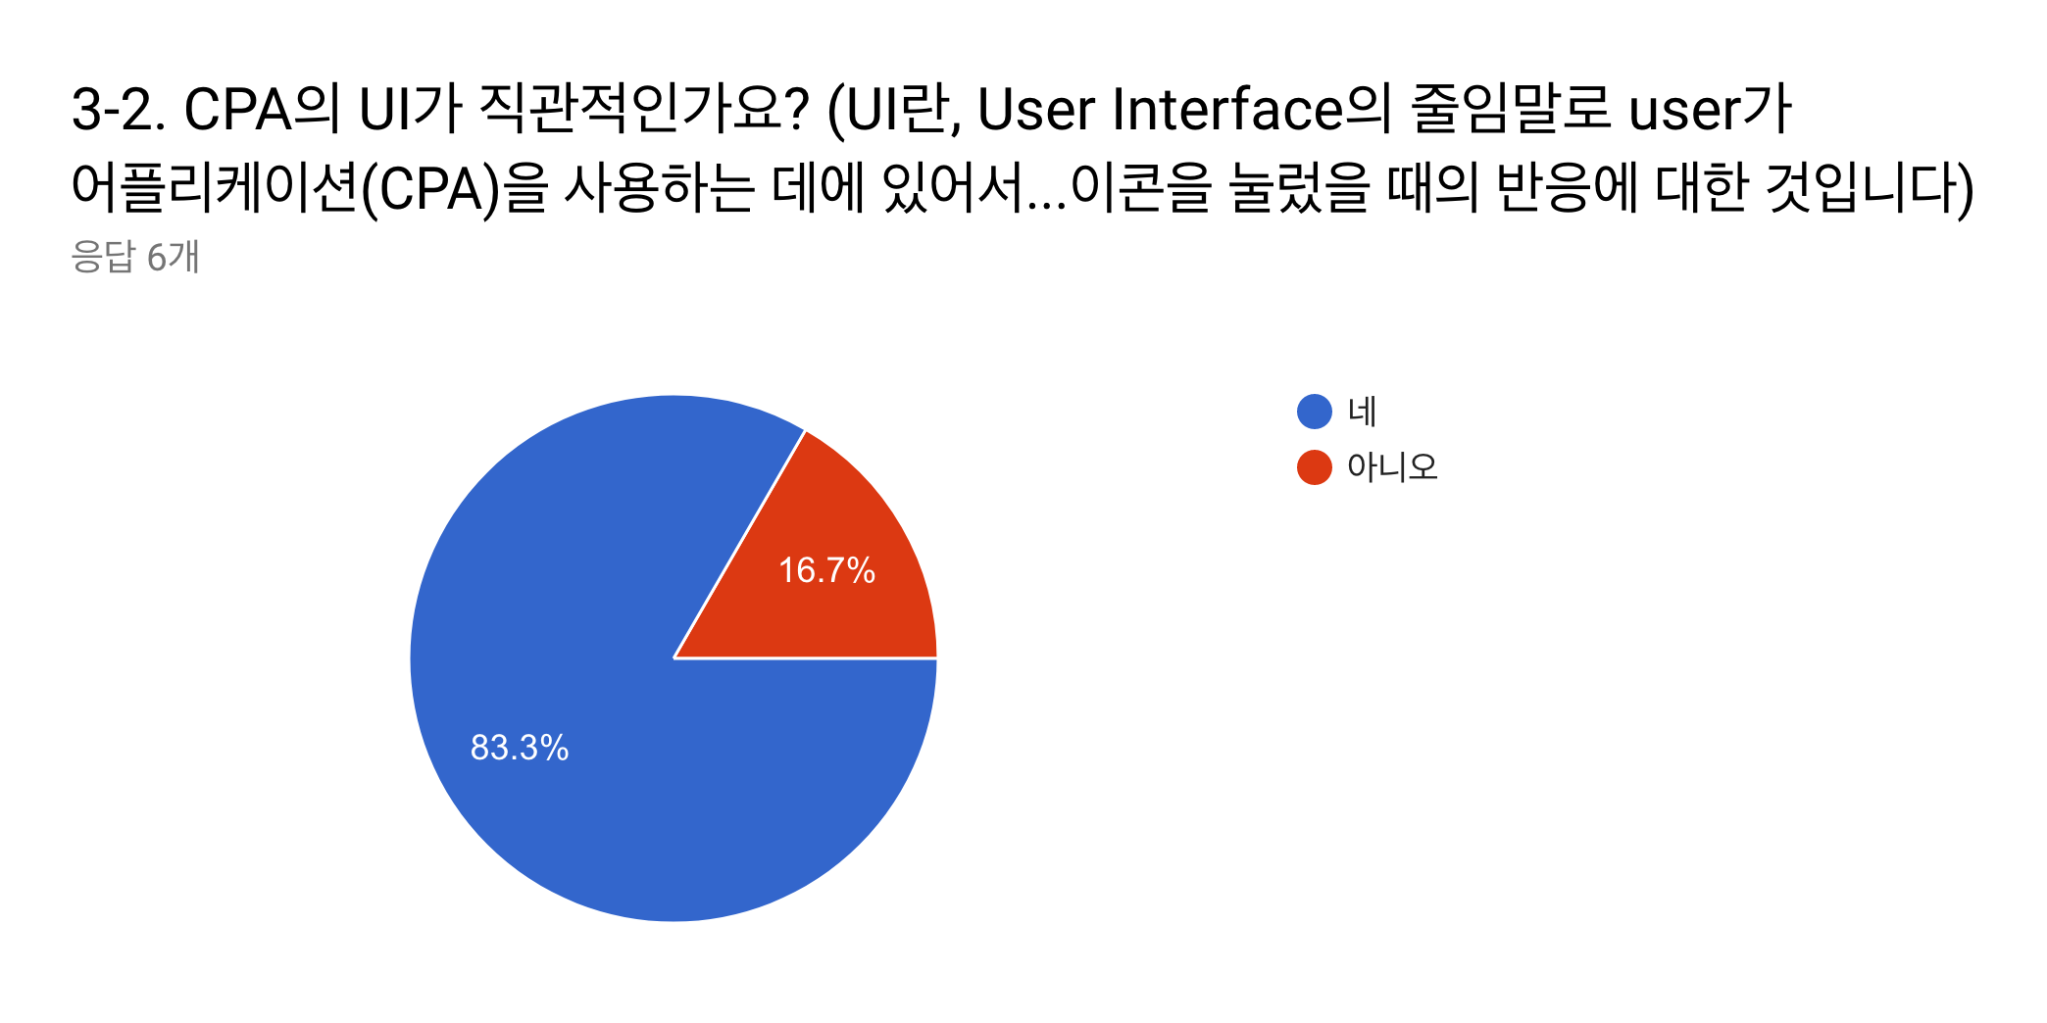
User Study: Result
CPA: Course Project Assistant
Group 2: Mobile Friendly UI
Is UI of CPA is intuitive?
Notes:
83 percent of responses said that UI of CPA is intuitive.

Slide 38
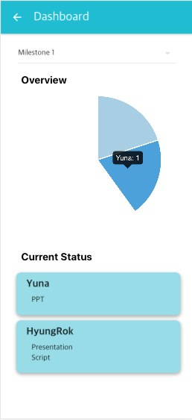

User Study: Result
CPA: Course Project Assistant
Group 2: Mobile Friendly UI
Is UI of CPA is intuitive?
Pie graph in dashboard is not intuitive
CPA is intuitive in general, but providing (+) button in milestone will be better
Notes:
There are some useful comments like pie chart and + button is not intuitive.

Slide 39
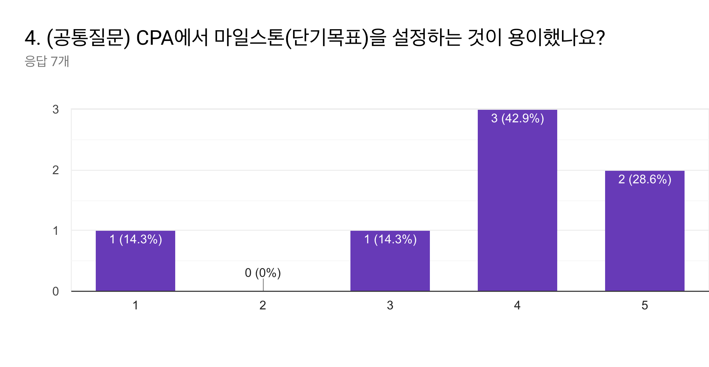
User Study: Result
CPA: Course Project Assistant
All: Milestone Setting
Does CPA provide easy milestone setting?
Notes:
Responses scored average 3.5 for easiness of setting milestones.

Slide 40
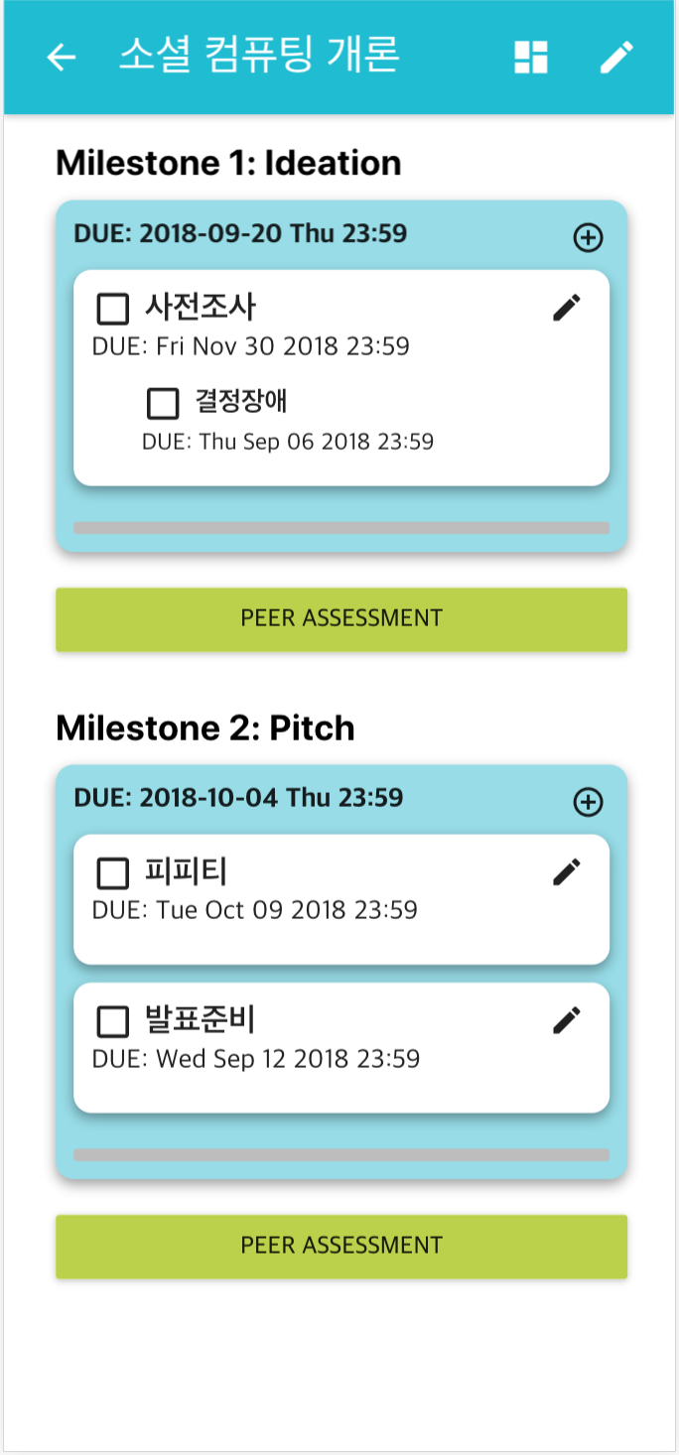
User Study: Result
CPA: Course Project Assistant
All: Milestone Setting
Does CPA provide easy milestone setting?
Providing autocomplete is good
Setting milestones with tasks at once will be better
Notes:
There are pros and cons in milestone settings.
One comment said that providing autocomplete is useful,
But setting milestones and tasks in different page is bothersome.
This is one of our users milestones.
Even if there are 5 milestones in CS473 course, he did not set all of those milestones.

Slide 41
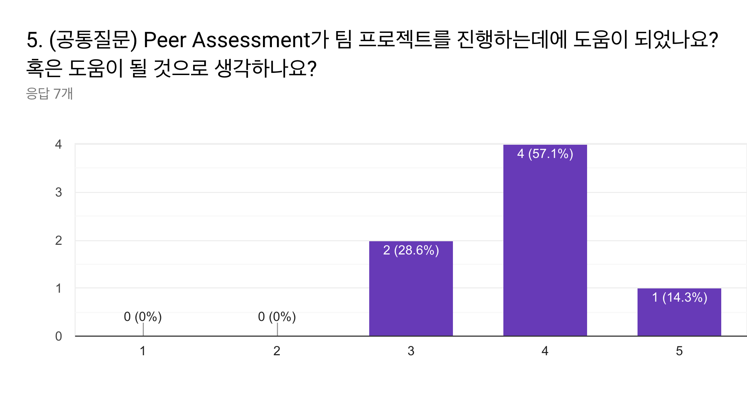
User Study: Result
CPA: Course Project Assistant
All: Peer Assessment
Do you think that peer assessment feature is helpful to course project?
Notes:
Responses scored average 3.9 for question that asks peer assessment.

Slide 42
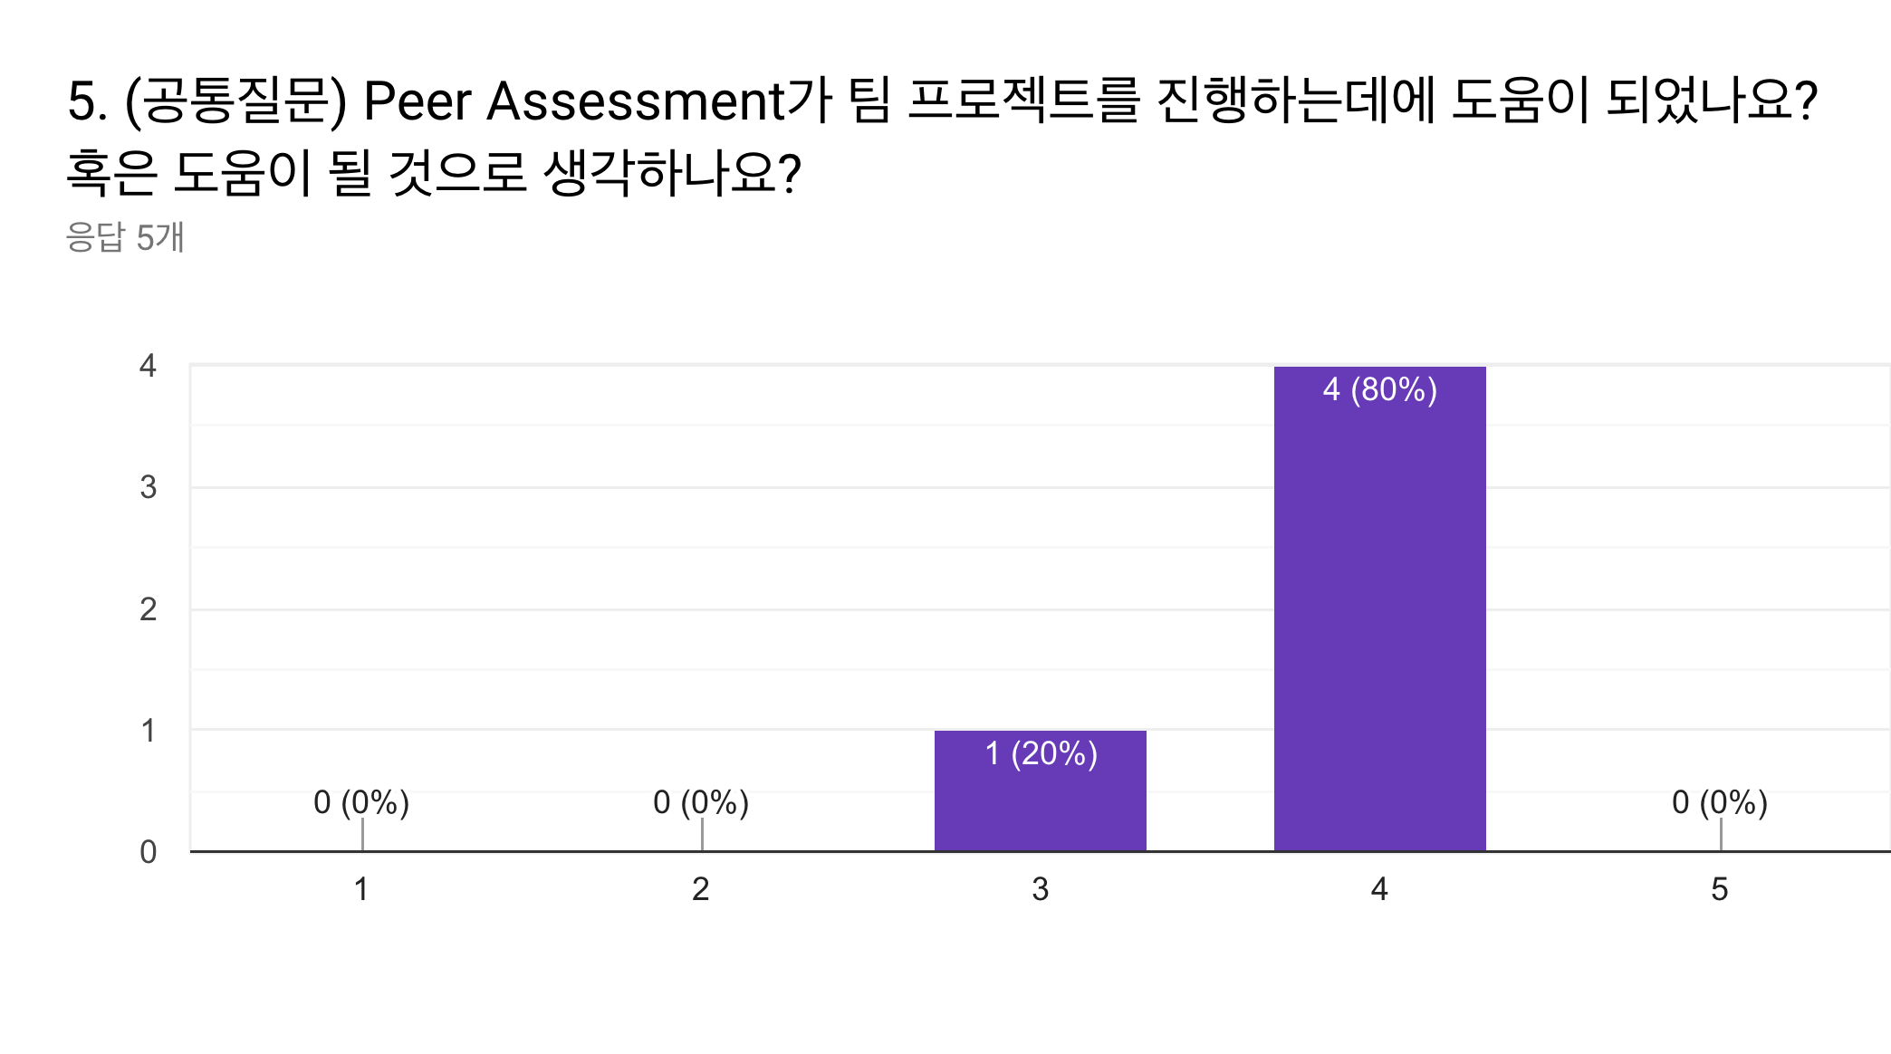

User Study: Result
CPA: Course Project Assistant
All: Peer Assessment
Do you think that peer assessment feature is helpful to team project?
It will be fine if there is no evil-minded members
People have different standard for evaluation. But it can motivates members.
Notes:
Feedbacks on peer assessment feature is that there might be trolls in peer assessments, but will motivate teammates.

Slide 43
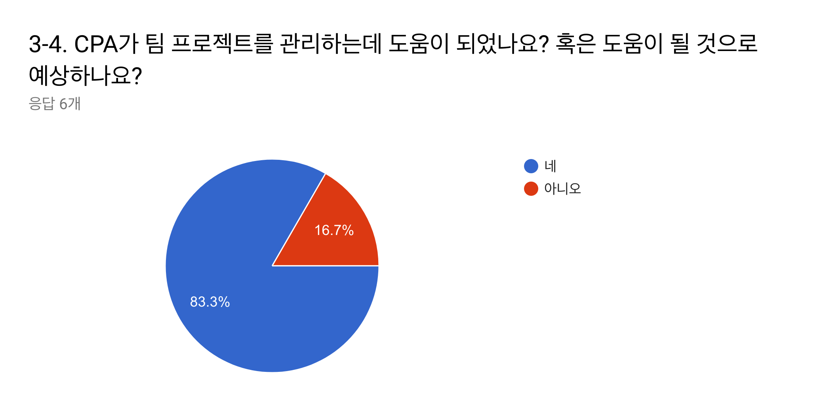
User Study: Result
CPA: Course Project Assistant
Group 2: Project Management
Is CPA helpful to manage course project?
Notes:
about 83 percent of responses said that CPA will be helpful to manage course project.

Slide 44

User Study: Result
CPA: Course Project Assistant
Group 2: Project Management
Is CPA helpful to manage project?
We can see current status so that responsibility of members increase and members can participate honestly.
Notes:
One of comment of this question said that teammates can see current status so that teammates can participate well.

Slide 45
User Study: Result
CPA: Course Project Assistant
User Behavior
User took average 3 minutes to set up milestones
Users took average 4 minutes to make a project
Users remained average 3 minutes at peer assessment / result
Notes:
This is pattern of user behavior we measured while doing user test.
We can see that users spends 3 minutes in setting milestones.
Users spent more time than we expected.

Slide 46
User Study: Summary
CPA: Course Project Assistant
PROS
CONS
Peer assessment motivates members
Mobile version
UI / Design
Difficulties with milestone setting
Trolls in peer assessment
Notes:
In summary, after conducting user test and survey,
We evaluated that providing peer assessment and mobile version is good for users.
However, one of our main feature, easiness of milestone setting did not worked well.
Also, we did not prevented trolls in peer assessment.

Slide 47
Future Plan
CPA: Course Project Assistant
Setting milestones more easily
( Less than one minutes )
Motivating users with peer assessment
( Collaboration rather than competition )
Notes:
So, our future plans are this.
First, we will make setting up milestones easier.
In order to do this, we will improve UI and provide templates of past course projects.
Second, we will motivate users with peer assessment.
Almost all users thought that peer assessment is encouraging competition not collaboration.
Therefore, we will design a new peer assessments for collaborative team.

Slide 48
CPA: Course Project Assistant
Manage Course Projects with
C P A
Notes:
This is end of our presentation.
Thank you for listening.

